Slide 1
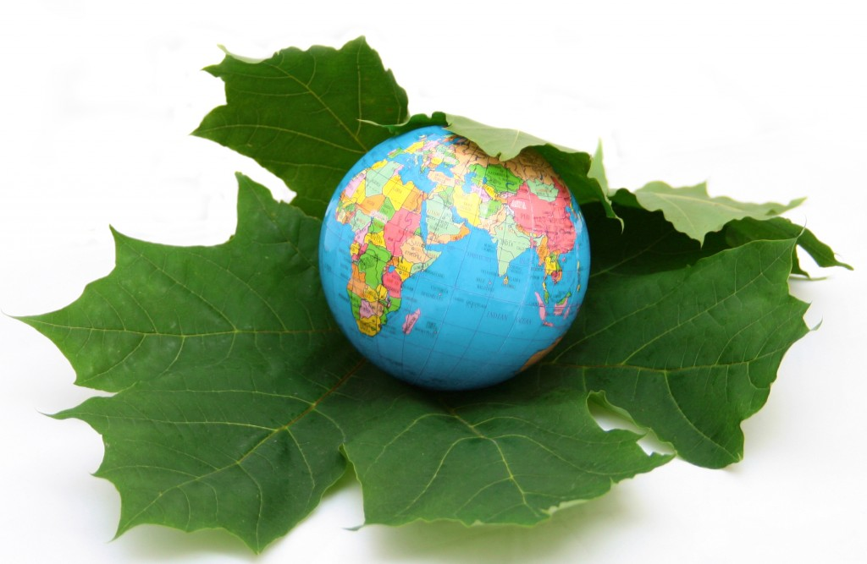
IMPACT OF CLIMATE CHANGE ON AGRICULTURAL CROPS IN PAKISTAN
BY
SYED MUHAMMAD SHIFAAT ZAIDI
CHAIRMAN
STANDING COMMITTEE ON PRODUCTS & SERVICES RECOGNITION,
FEDERATION OF PAKISTAN CHAMBERS OF COMMERCE & INDUSTRY
FORMER CHAIRMAN STANDING COMMITTEE ON ENVIRONMENT- FPCCI
FORMER PRESIDENT , PAKISTAN SOCIETY OF SUGAR TECHNOLOGISTS

Slide 2
AGRICULTURE- BACKBONE OF PAKISTAN’S ECONOMY
Pakistan is an agricultural country, with about half of its population earning their livelihood from this sector.
This sector contributes about 22% to GDP.
Pakistan earns a high percentage of its foreign exchange from agriculture alone, approximately 70 %. Unless it maintains stable growth rates, its economy will suffer immensely.

Slide 3
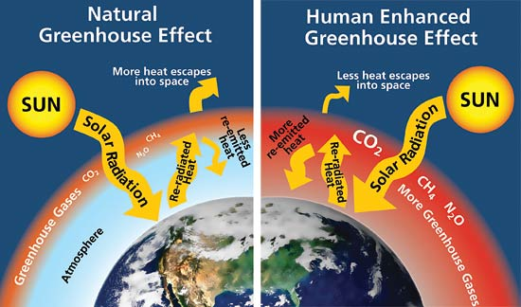
How the Climate is Changing
Due to increased fossil fuel burning more Carbon di oxide is released in the air. CO2 has the ability to trap heat, therefore, increasing temperature of the surface of the earth.

Slide 4
CLIMATE CHANGE VULNERABILITIES
The fertile terrain of our country is the cradle of Pakistan’s agriculture. It is presently threatened by the vagaries of Climate Change, largely induced through rise in global warming.
Higher concentrations of carbon dioxide can have beneficial impacts on crops. However rising temperatures and reduced precipitation cause havoc with the biological complexities thus resulting in lesser yield per acre.

Slide 5
CLIMATE CHANGE & AGRICULTURE
● Reduced water availability
● Drastic reduction in cereal production, e.g wheat and rice, as well as cotton and sugarcane.
● In southern Pakistan yields of major cereals predicted to decline by 15-20% by Regional Climate Change Models
● In the northern area minor improvements in yield due to increased duration of growing period
● Livestock production predicted to decline by 25%, creating crises in milk, meat and poultry supplies and pushing prices at very high level, beyond the reach of common man.
● Pakistan is already amongst the forest/tree resource-poor countries in the world with a meager 5.2% forest cover as against 25 requirement.

Slide 6
CLIMATE CHANGE & AGRICULTURE II
Pakistan is ranked 28th in the list of countries most effected by climate change variations
Climate variations give rise to new species of insects, worms, pests and other related species. The rise is anomalous!
It becomes hard for farmers to utilize agricultural land to its full potential due to unpredictable weather patterns hence reduced yield and loss of production.

Slide 7
REQUIRED ADAPTATION
Pakistan needs to put in immediate Adaptation Measures directed at its agriculture sector that will help stabilize its agricultural growth rate at around 5% above the population growth rate of 2.4%.
This needs:
Investment in research and development that provides solutions to high-stress agriculture
Hi-tech meteorological services along with early warning systems to predict floods, drought, cyclones, tsunamis, wind shear, fog, hailstorms, etc.
Breeding of livestock species and multiplication of seed varieties that are resistant to drought
Building up food reserves to cater for extreme events

Slide 8
REQUIRED ADAPTATIONS II
Development of an Action Plan that focuses on adaptation and mitigation measures
To enable sustainable growth in agriculture
Financial resources to the tune of US $30 billion or more to address the needs of
agriculture alone over the next 10 years
Know-how, farmer training and capacity building for the highly diversified
agro-ecological zones
Technology transfer in the area of renewable energy at farm level and green
technologies to save the environment from the vagaries of Climate Change
Massive investment in forest and tree cover across the board with due attention paid to special ecologies, e.g. the coastal belt, where mangroves are the most
suitable
Lastly, a major focus on the youth and children to prepare them to face the
consequences of Climate Change. Their education and involvement are a vital part
of any sensible strategy!

Slide 9
THANK YOU.

